Slide 1
Chapter 1: Diodes and Applications
Module – 3 : Voltage Regulators
Reference: Robert L. Boylestad, Louis Nashelsky, Electronic Devices & Circuits Theory, 11th Edition, PHI, 2012

Slide 2
At the end of this module, students will be able to:
Describe the working of Zener diode
Explain how Zener diode can be used as a voltage regulator

Slide 3
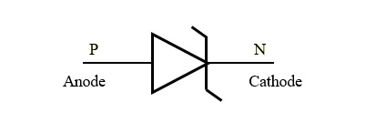
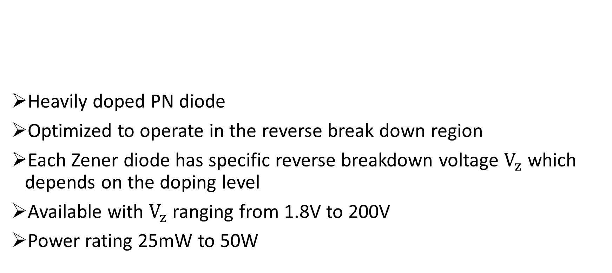
Zener Diode
Heavily doped PN diode
Optimized to operate in the reverse break down region
Each Zener diode has specific reverse breakdown voltage $V_{z}$ which depends on the doping level
Available with $V_{z}$ ranging from 1.8V to 200V
Power rating 25mW to 50W

Slide 4
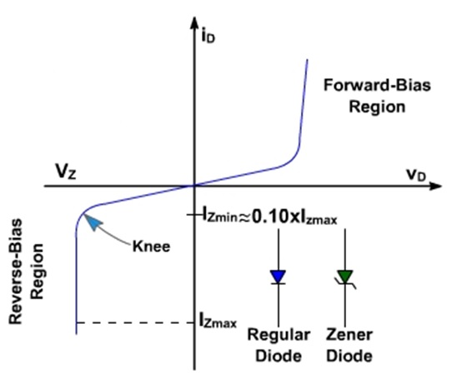
VI Characteristics

Slide 5
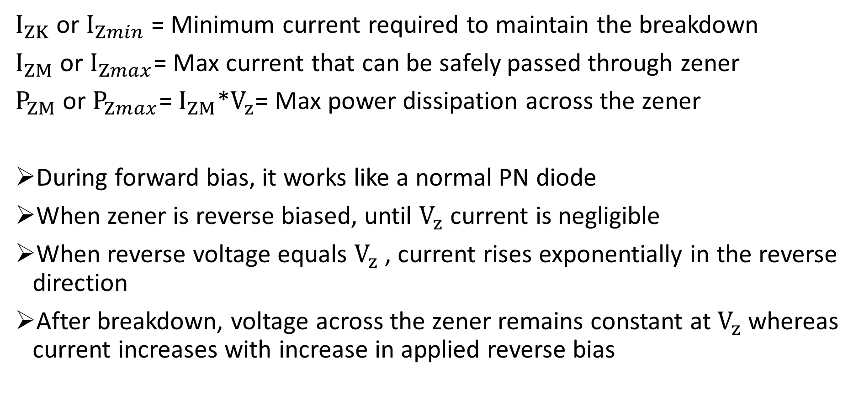
$I_{ZK}$ or $I_{Zmin}$ = Minimum current required to maintain the breakdown
$I_{ZM}$ or $I_{Zmax}$= Max current that can be safely passed through zener
$P_{ZM}$ or $P_{Zmax}$= $I_{ZM}$*$V_{z}$= Max power dissipation across the zener
During forward bias, it works like a normal PN diode
When zener is reverse biased, until $V_{z}$ current is negligible
When reverse voltage equals $V_{z}$ , current rises exponentially in the reverse direction
After breakdown, voltage across the zener remains constant at $V_{z}$ whereas current increases with increase in applied reverse bias

Slide 6
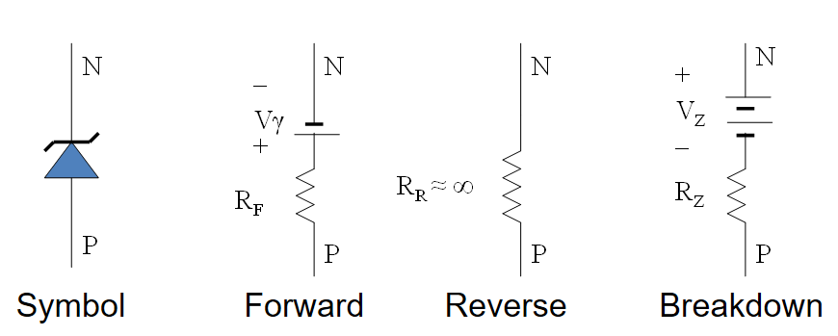
Equivalent Circuit

Slide 7
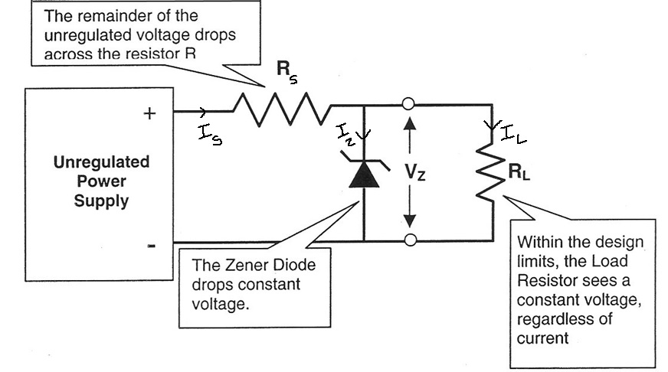
Zener Voltage Regulator

Slide 8
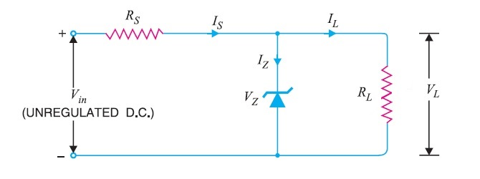


Case (1): Both $V_{i}$ and $R_{L}$ are fixed
Determine the state of the diode: whether ON or OFF
If $V_{L}$ ≥ $V_{z}$ , zener diode is ON , appropriate equivalent circuit is substituted
If $V_{L}$ < $V_{z}$ , zener diode is OFF , open circuit equivalent is substituted
As long as zener is ON,
$V_{L}$ = $V_{z}$ voltage across parallel elements

Slide 11

Calculate the currents using KCL
$I_{S}$ = $I_{Z}$ + $I_{L}$
→ $I_{Z}$ = $I_{S}$ - $I_{L}$
Where, $I_{L}$=$\frac{V_{L}}{R_{L}}$ ; $I_{S}$=$\frac{V_{S}}{R_{S}}$ = $\frac{V_{i}−V_{L}}{R_{S}}$
Power dissipated through the zener is given by $P_{Z}$= $V_{z}$*$I_{Z}$

Slide 12
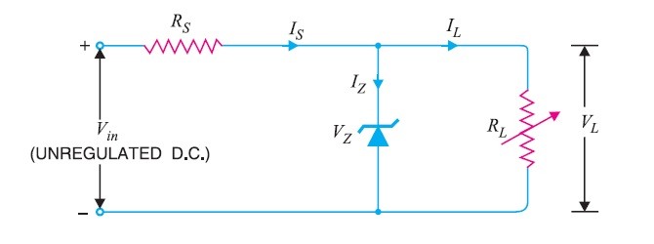

Case (2): Fixed $V_{i}$ and variable $R_{L}$ (Load Regulation)
Expected: Variation in load resistance $R_{L}$ should not affect load voltage $V_{L}$
To find: Range of values of $R_{L}$ ($R_{Lmin}$to $R_{Lmax}$) for which load voltage is constant.

Slide 13
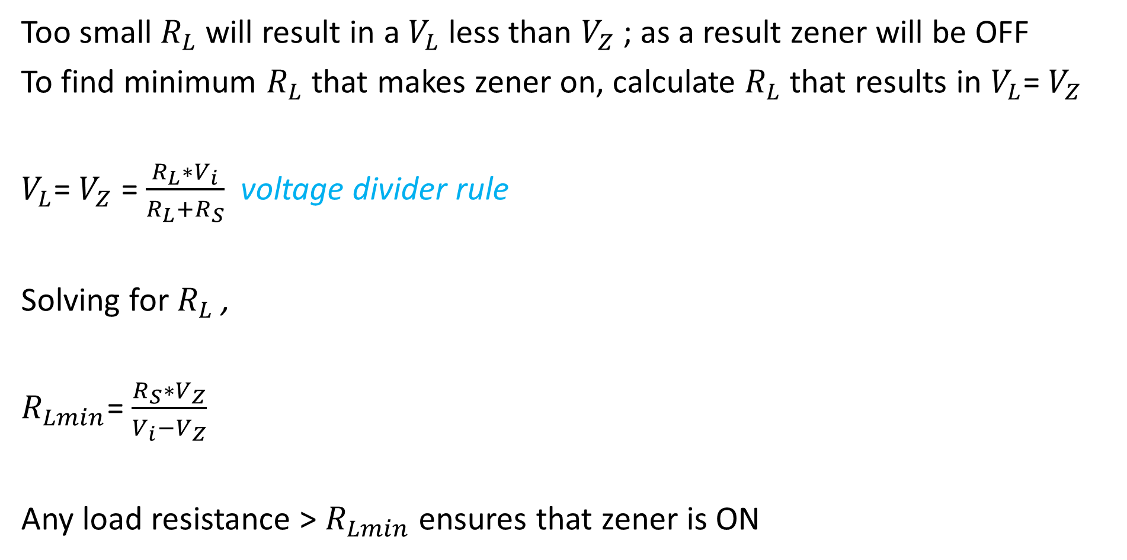
Too small $R_{L}$ will result in a $V_{L}$ less than $V_{Z}$ ; as a result zener will be OFF
To find minimum $R_{L}$ that makes zener on, calculate $R_{L}$ that results in $V_{L}$= $V_{Z}$
$V_{L}$= $V_{Z}$ = $\frac{R_{L}∗V_{i}}{R_{L}+R_{S}}$ voltage divider rule
Solving for $R_{L}$ ,
$R_{Lmin}$= $\frac{R_{S}∗V_{Z}}{V_{i}−V_{Z}}$
Any load resistance > $R_{Lmin}$ ensures that zener is ON

Slide 14

WKT, $I_{L}$=$\frac{V_{L}}{R_{L}}$ -----------(1)
When $R_{L}$ is $R_{Lmin}$ , $I_{L}$ is at $I_{Lmax}$
Also, when the zener is on, $V_{L}$=$V_{Z}$
$I_{Lmax}$= $\frac{V_{Z}}{R_{Lmin}}$ ------------from equation (1)
$R_{Lmin}$= $\frac{V_{Z}}{I_{Lmax}}$

Slide 15
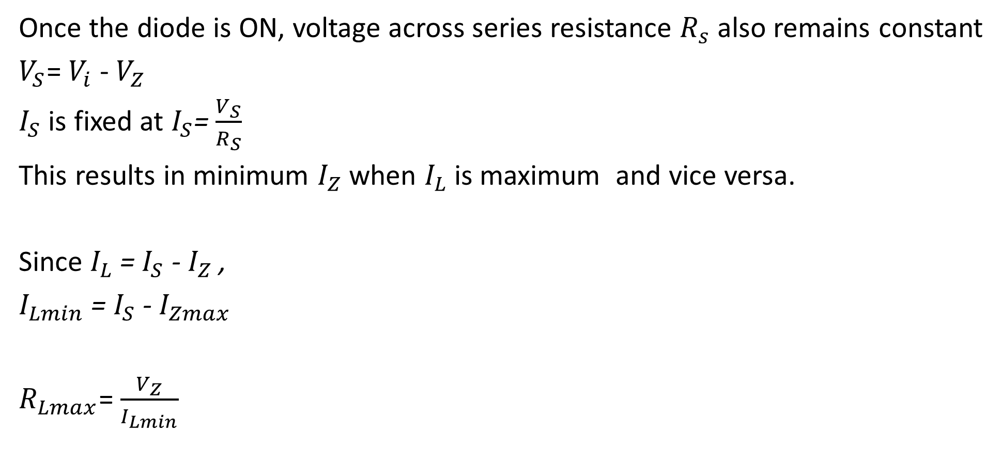
Once the diode is ON, voltage across series resistance $R_{s}$ also remains constant
$V_{S}$= $V_{i}$ - $V_{Z}$
$I_{S}$ is fixed at $I_{S}$=$\frac{V_{S}}{R_{S}}$
This results in minimum $I_{Z}$ when $I_{L}$ is maximum and vice versa.
Since $I_{L}$ = $I_{S}$ - $I_{Z}$ ,
$I_{Lmin}$ = $I_{S}$ - $I_{Zmax}$
$R_{Lmax}$= $\frac{V_{Z}}{I_{Lmin}}$

Slide 16
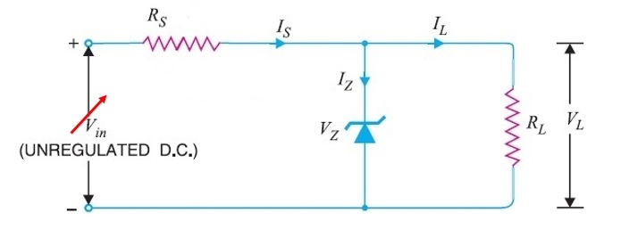

Case (3): Fixed $R_{L}$ and variable $V_{i}$(Line Regulation)
Expected: Variation in input voltage $V_{i}$ should not affect load voltage $V_{L}$
To find: Range of values of $V_{i}$ ($V_{imin}$to$V_{imax}$) for which load voltage is constant.

Slide 17
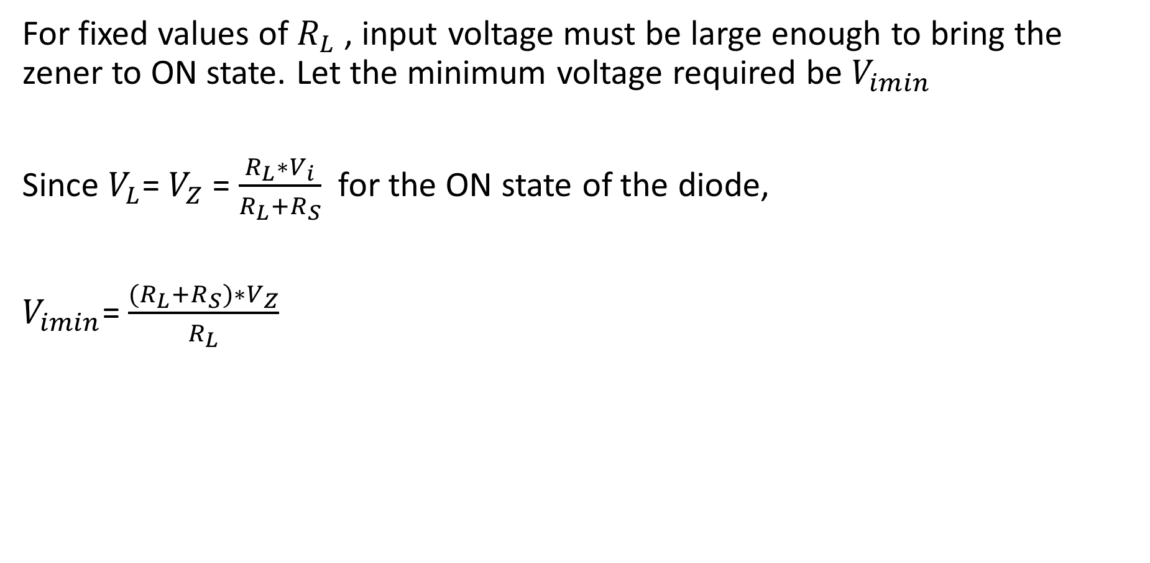
For fixed values of $R_{L}$ , input voltage must be large enough to bring the zener to ON state. Let the minimum voltage required be $V_{imin}$
Since $V_{L}$= $V_{Z}$ = $\frac{R_{L}∗V_{i}}{R_{L}+R_{S}}$ for the ON state of the diode,
$V_{imin}$= $\frac{{(R}_{L}+R_{S})∗V_{Z}}{R_{L}}$

Slide 18

Maximum $V_{i}$ results in maximum current through $I_{S}$
Since $V_{i}$ is limited by maximum zener current $I_{Zmax}$ and $I_{L}$ is fixed,
$I_{Smax}$ = $I_{Zmax}$ + $I_{L}$
$V_{imax}$= $V_{Smax}$+ $V_{Z}$
$V_{imax}$= $(I_{Smax}∗R_{S})$+ $V_{Z}$

Slide 19
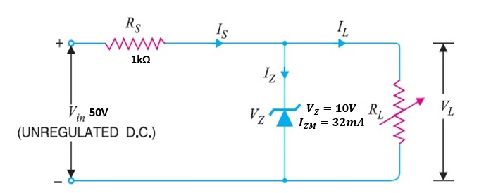

Q1. For the circuit shown below, determine the range of $R_{L}$ and $I_{L}$ that results in $V_{L}$ being maintained at 10V.

Slide 20
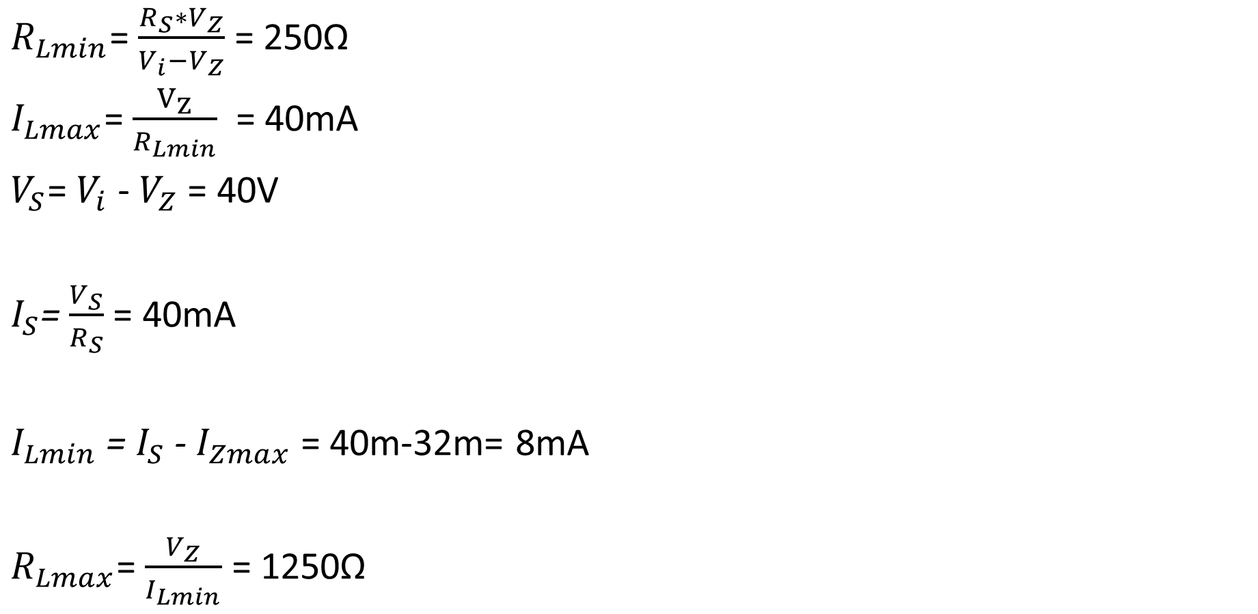
$R_{Lmin}$= $\frac{R_{S}∗V_{Z}}{V_{i}−V_{Z}}$ = 250Ω
$I_{Lmax}$= $\frac{V_{Z}}{R_{Lmin}}$ = 40mA
$V_{S}$= $V_{i}$ - $V_{Z}$ = 40V
$I_{S}$=$\frac{V_{S}}{R_{S}}$ = 40mA
$I_{Lmin}$ = $I_{S}$ - $I_{Zmax}$ = 40m-32m= 8mA
$R_{Lmax}$= $\frac{V_{Z}}{I_{Lmin}}$ = 1250Ω

Slide 21
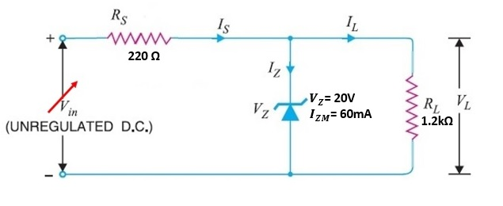

Q2. For the circuit shown below, determine the range of $V_{i}$ that will maintain the zener in the ON state.

Slide 22

$V_{Z}$ = $\frac{R_{L}∗V_{i}}{R_{L}+R_{S}}$
$V_{imin}$= $\frac{{(R}_{L}+R_{S})∗V_{Z}}{R_{L}}$ = 23.66V
$I_{L}$=$\frac{V_{Z}}{R_{L}}$ = 16.66mA
$I_{Smax}$ = $I_{Zmax}$ + $I_{L}$= 60m+16.66m= 76.66mA
$V_{imax}$= $V_{Smax}$+ $V_{Z}$
$V_{imax}$= $(I_{Smax}∗R_{S})$+ $V_{Z}$ = 36.87V

Slide 23
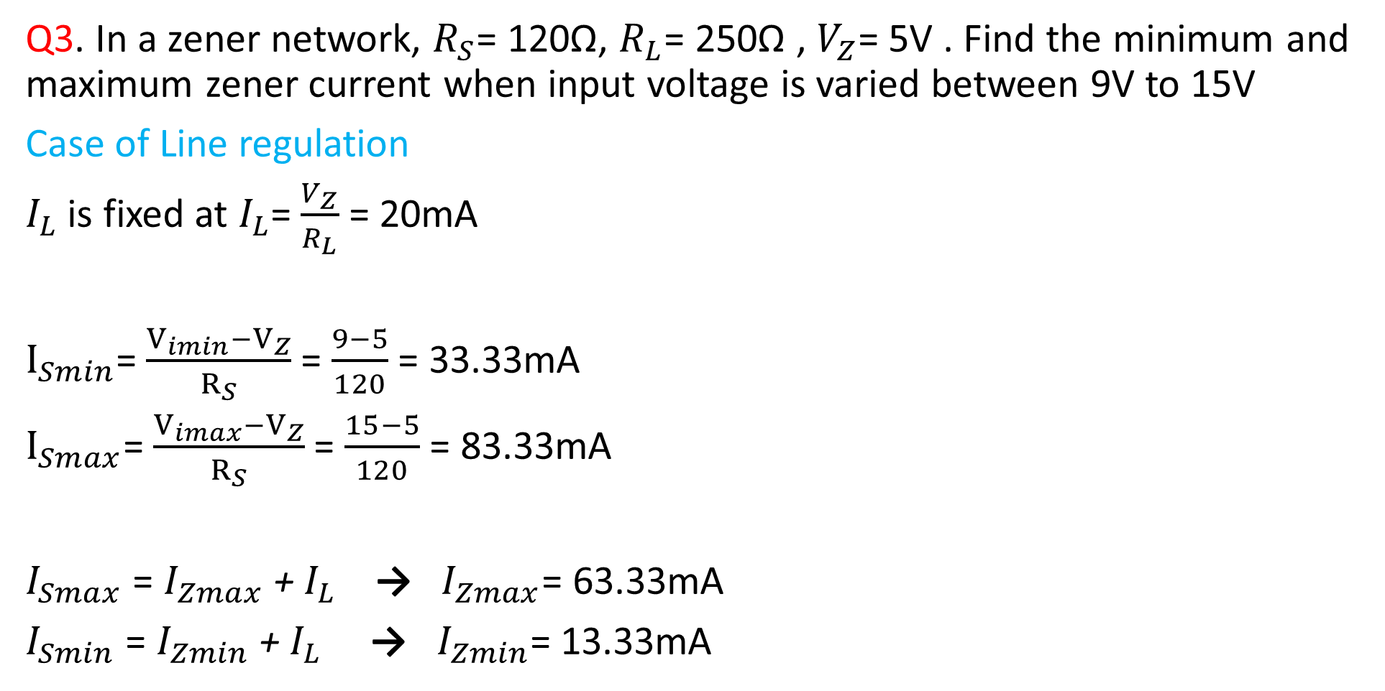
Q3. In a zener network, $R_{S}$= 120Ω, $R_{L}$= 250Ω , $V_{Z}$= 5V . Find the minimum and maximum zener current when input voltage is varied between 9V to 15V
Case of Line regulation
$I_{L}$ is fixed at $I_{L}$=$\frac{V_{Z}}{R_{L}}$ = 20mA
$I_{Smin}$=$\frac{V_{imin}−V_{Z}}{R_{S}}$ = $\frac{9−5}{120}$ = 33.33mA
$I_{Smax}$=$\frac{V_{imax}−V_{Z}}{R_{S}}$ = $\frac{15−5}{120}$ = 83.33mA
$I_{Smax}$ = $I_{Zmax}$ + $I_{L}$ → $I_{Zmax}$= 63.33mA
$I_{Smin}$ = $I_{Zmin}$ + $I_{L}$ → $I_{Zmin}$= 13.33mA

Slide 24
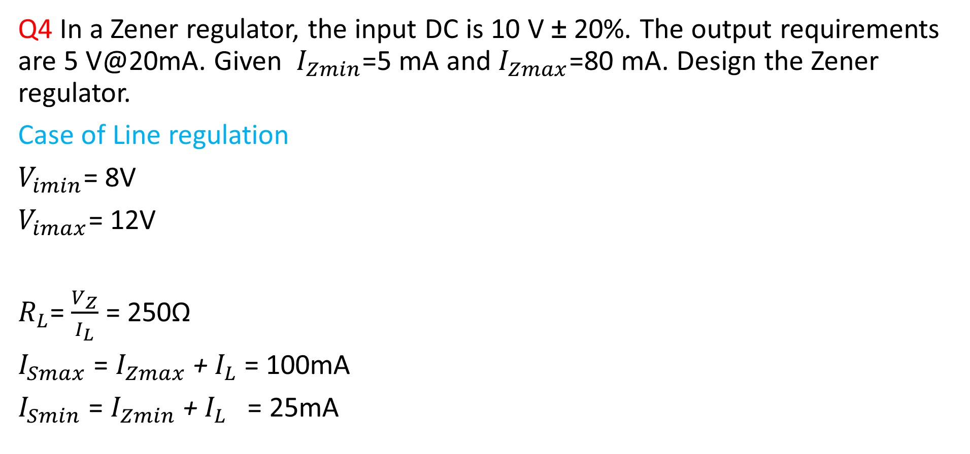
Q4 In a Zener regulator, the input DC is 10 V ± 20%. The output requirements are 5 V@20mA. Given $I_{Zmin}$=5 mA and $I_{Zmax}$=80 mA. Design the Zener regulator.
Case of Line regulation
$V_{imin}$= 8V
$V_{imax}$= 12V
$R_{L}$= $\frac{V_{Z}}{I_{L}}$ = 250Ω
$I_{Smax}$ = $I_{Zmax}$ + $I_{L}$ = 100mA
$I_{Smin}$ = $I_{Zmin}$ + $I_{L}$ = 25mA

Slide 25

$R_{Smax}$=$\frac{V_{imin}−V_{L}}{I_{Smin}}$ = $\frac{8−5}{25mA}$ = 120Ω
$R_{Smin}$=$\frac{V_{imax}−V_{L}}{I_{Smax}}$ = $\frac{12−5}{100mA}$ = 70Ω

Slide 26
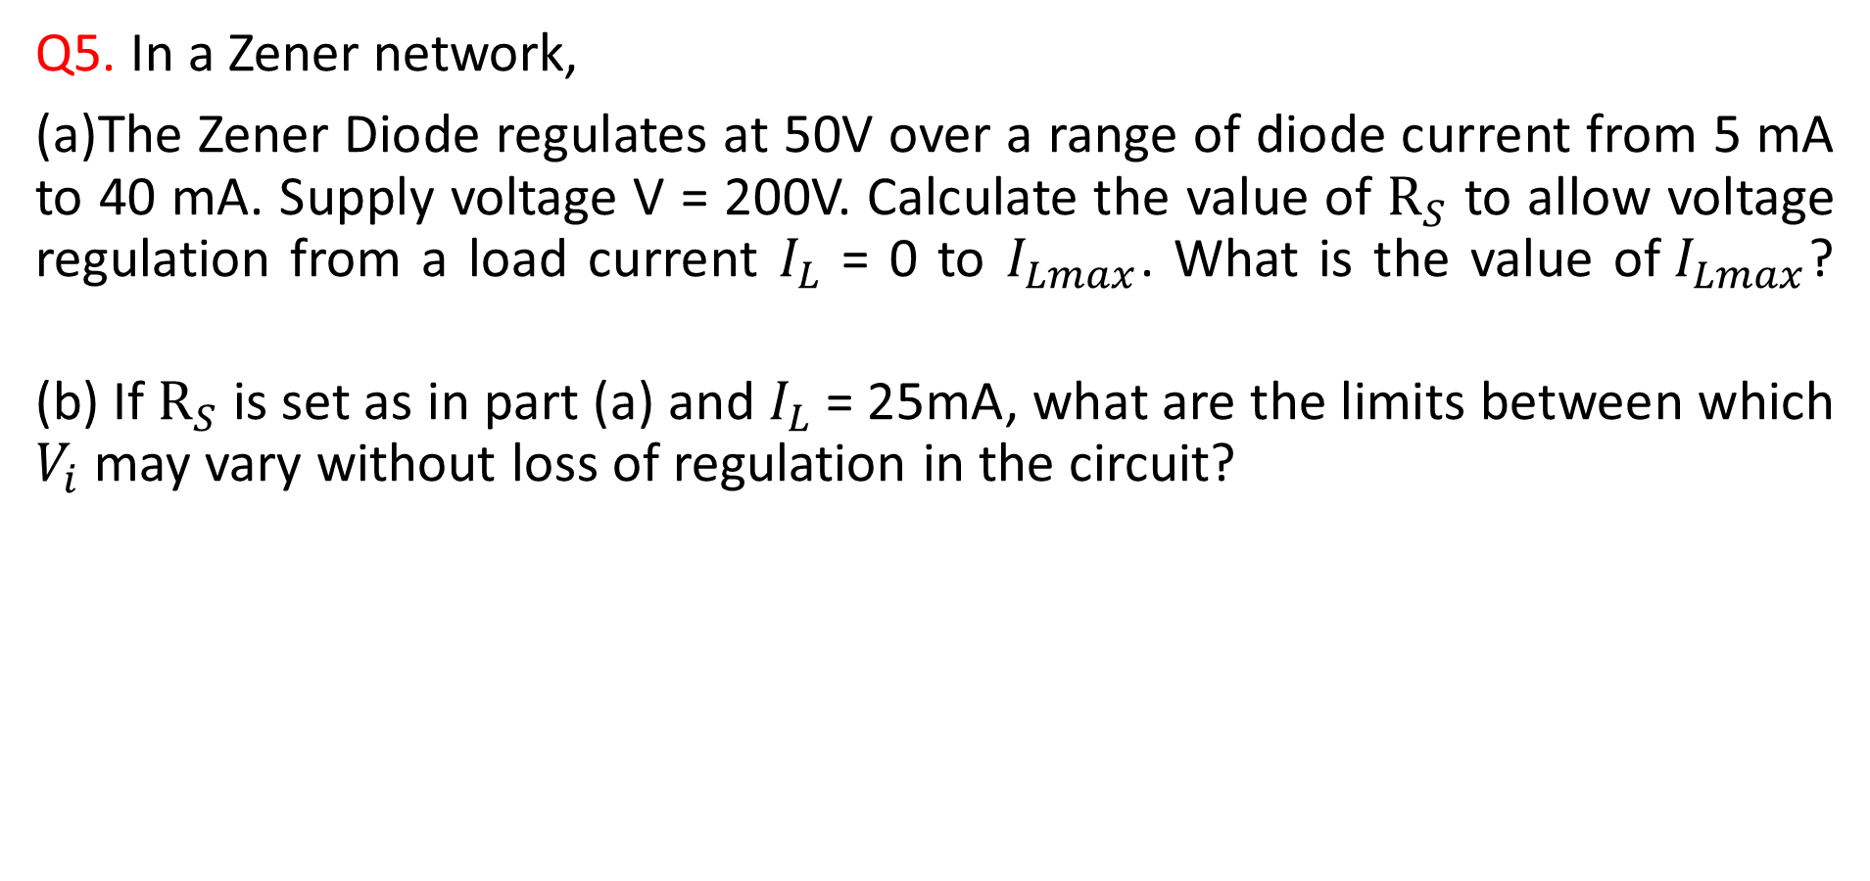
Q5. In a Zener network,
(a)The Zener Diode regulates at 50V over a range of diode current from 5 mA to 40 mA. Supply voltage V = 200V. Calculate the value of $R_{S}$ to allow voltage regulation from a load current $I_{L}$ = 0 to $I_{Lmax}$. What is the value of${ I}_{Lmax}$?
(b) If $R_{S}$ is set as in part (a) and $I_{L}$ = 25mA, what are the limits between which $V_{i}$ may vary without loss of regulation in the circuit?

Slide 27

(a) $V_{i}$= 200V
$V_{Z}$ = 50V
$I_{Zmax}$= 40mA ; $I_{Zmin}$= 5mA
$I_{S}$= $I_{Zmax}$+$I_{Lmin}$
= 40mA
$I_{S}$= $I_{Zmin}$+$I_{Lmax}$
→ $I_{Lmax}$= 40m-5m = 35mA
$R_{S}$= $\frac{V_{i}−V_{Z}}{I_{S}}$ = $\frac{200−50}{40m}$ = 3750Ω

Slide 28

(b)
$I_{Smax}$= $I_{Zmax}$+$I_{L}$
= 40m+25m= 65mA
$I_{Smin}$ = $I_{Zmin}$+$I_{L}$
= 5m+25m= 30mA
$V_{imin}$= $(I_{Smin}∗R_{S})$+ $V_{Z}$ = 162.5V
$V_{imax}$= $(I_{Smax}∗R_{S})$+ $V_{Z}$ =293.7V

Slide 29
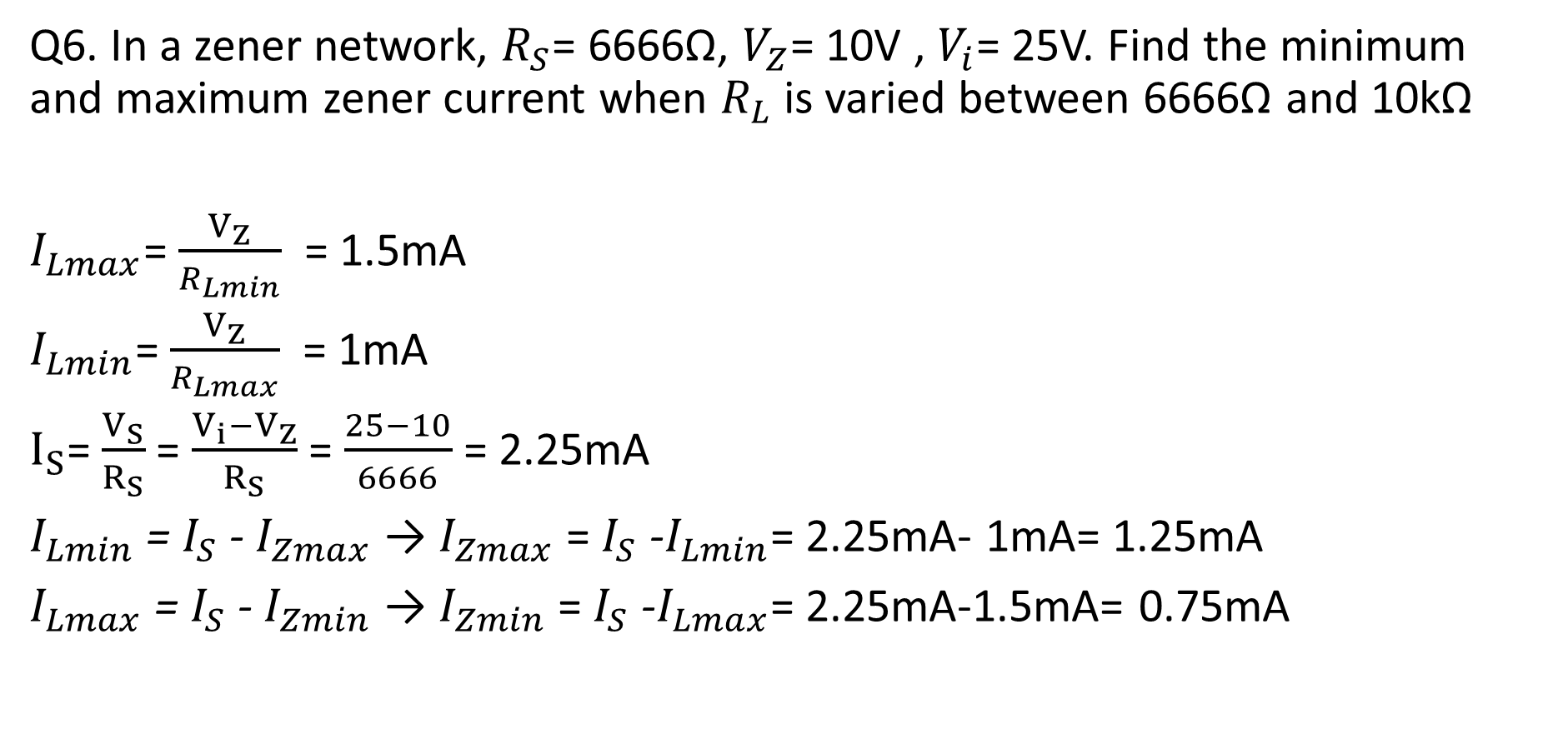
Q6. In a zener network, $R_{S}$= 6666Ω, $V_{Z}$= 10V , $V_{i}$= 25V. Find the minimum and maximum zener current when $R_{L}$ is varied between 6666Ω and 10kΩ
$I_{Lmax}$= $\frac{V_{Z}}{R_{Lmin}}$ = 1.5mA
$I_{Lmin}$= $\frac{V_{Z}}{R_{Lmax}}$ = 1mA
$I_{S}$=$\frac{V_{S}}{R_{S}}$ = $\frac{V_{i}−V_{Z}}{R_{S}}$ = $\frac{25−10}{6666}$ = 2.25mA
$I_{Lmin}$ = $I_{S}$ - $I_{Zmax}$ → $I_{Zmax}$ = $I_{S}$ -$I_{Lmin}$= 2.25mA- 1mA= 1.25mA
$I_{Lmax}$ = $I_{S}$ - $I_{Zmin}$ → $I_{Zmin}$ = $I_{S}$ -$I_{Lmax}$= 2.25mA-1.5mA= 0.75mA

Slide 30

Exercise: Design a zener regulator circuit to meet the following specifications:
Load voltage=8V, input voltage=30 V, Load current=0-50 mA, $I_{Zmin}$= 5mA, $P_{ZM}$= 1W

Slide 31
LED
Photo Diode
Opto Coupler
Solar Cell
Diode as a capacitor
Exercise

